Slide 1

Today in science…
Kind of..
“We’ve been conditioned… to focus on our talents, and to let them define us. These descriptors might limit us, but they also comfort us... they do not readily leave room for attempting something new—and sucking at it”
Consider your positionality sitting in this classroom.
Stereotype threat
Growth mindset
Notes:
This is what I read this weekend, I think it applies to learning physics as well as anything else new

Slide 2
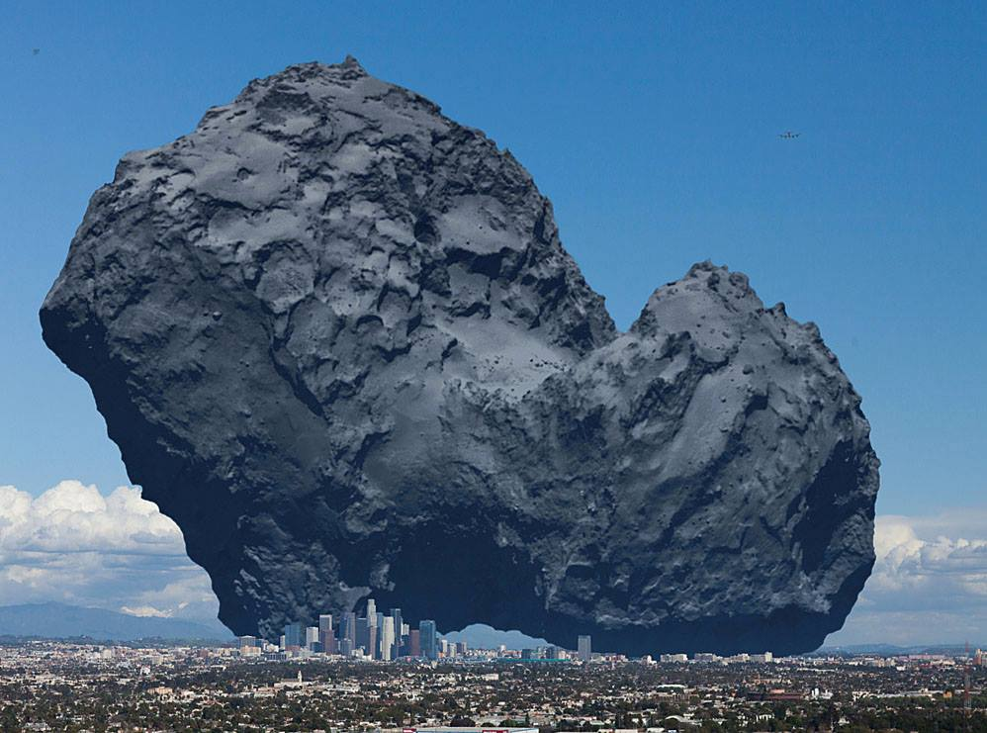
(Yester-)Today in science…
Throwback Tuesday on the Rosetta Mission!
Rosetta = orbiter
Philae = lander
Notes:
67P compared to Denver, I’m pretty sure https://twitter.com/AntonioParis/status/1039274847719829504
67P/Churyumov-Gerasimenko is the full name of the comet

Slide 3
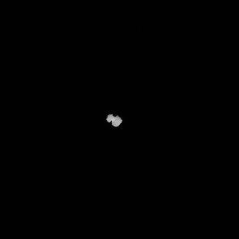
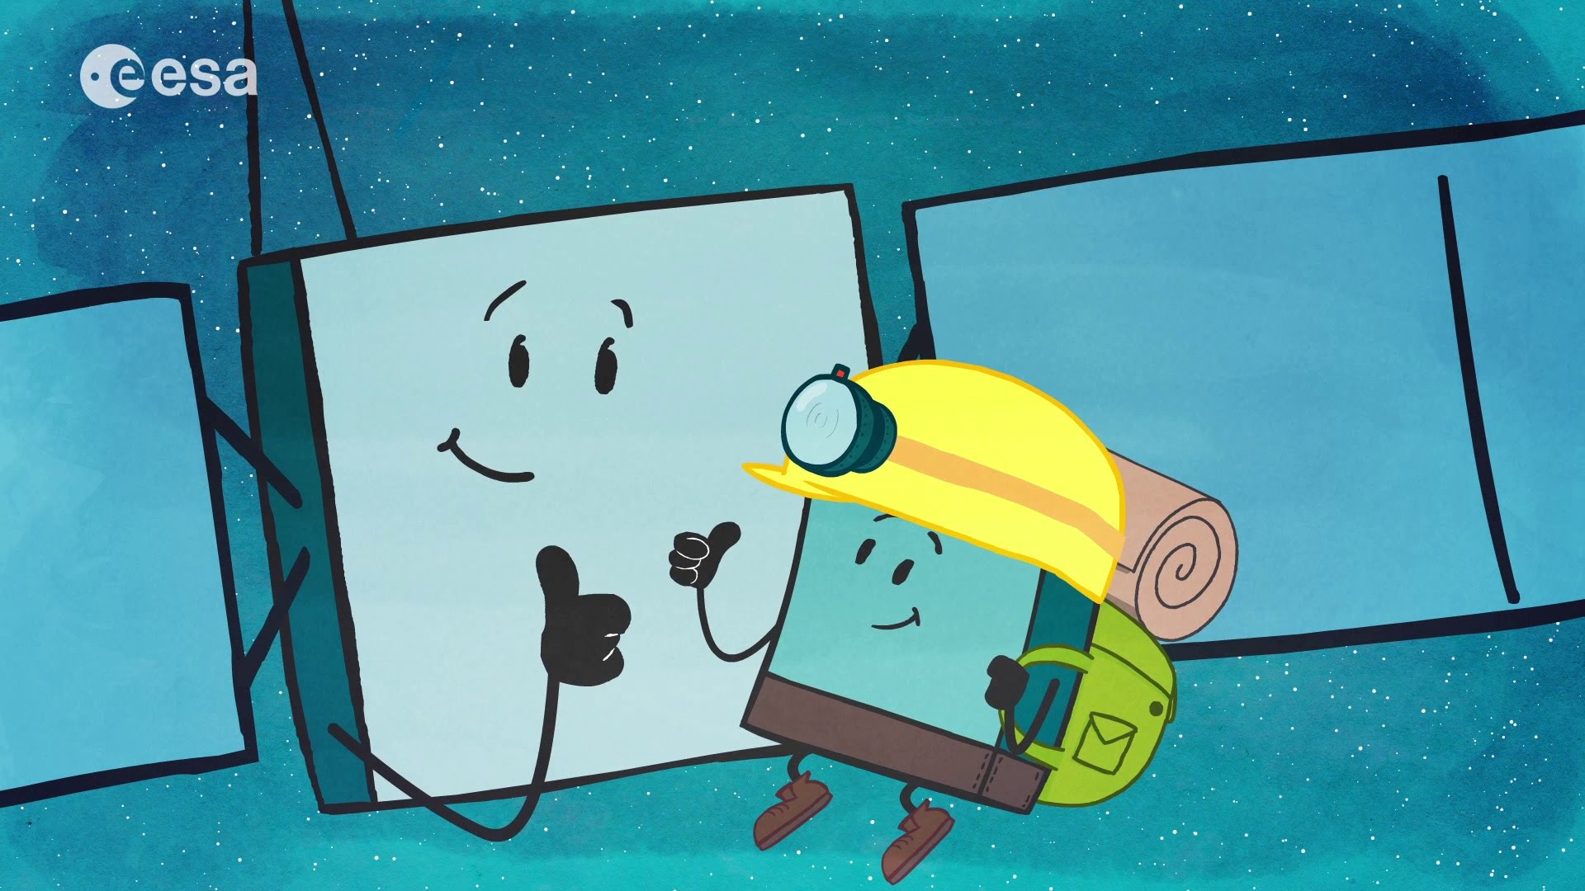
Why did Philae bounce?
F_{g}!
A little math… what is acceleration due to gravity on the comet, and how does that compare to Earth?
Fg = G M_{comet} M_{Philae} = M_{Philae}*a
R_{comet}²
6.67x10⁻¹¹ m³ kg⁻¹ s⁻² * 10¹³kg = a_{comet}
(4000m)²
4.17x10⁻⁵ m/s² = a_{comet} (compare to 9.8 m/s² on Earth!)
Notes:
http://sci.esa.int/rosetta/14615-comet-67p/

Slide 4

Properties of light
The Cosmic Perspective, Chapter 5, 5.1-5.2

Slide 5
Recap of last time
Last time, we talked about the behavior of light
Light is emitted
It can be absorbed, transmitted, reflected, diffracted, scattered, and it can interfere
Scattering depends on size of scatterer (molecules in atmosphere, clouds) and the wavelength of the light
Blue efficiently scattered in atmosphere, red not
Higher energy
Lower energy
Notes:
Light can have

Slide 6

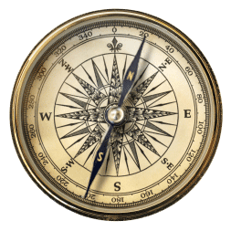
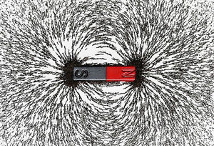
Let’s talk about fields again
A field tells you how much two things will interact depending on where they are relative to each other.
Magnetic fields
Electric fields
Gravitational fields
Notes:
I’m afraid that last time I went too fast and might have given you the idea that light is a stream of charged particles.. It is not.

Slide 7
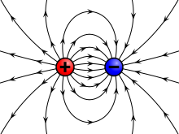
Let’s talk about fields again
A field tells you how much two things will interact depending on where they are relative to each other.
Magnetic fields
Electric fields
Gravitational fields
Notes:
I’m afraid that last time I went too fast and might have given you the idea that light is a stream of charged particles.. It is not.

Slide 8
Let’s talk about fields again
A field tells you how much two things will interact depending on where they are relative to each other.
Magnetic fields
Electric fields
Gravitational fields
Every day, we are surrounded by, and move through, fields
Charged particles interact with magnetic, electric fields
Light and massive objects interact with gravitational fields
Notes:
I’m afraid that last time I went too fast and might have given you the idea that light is a stream of charged particles.. It is not.

Slide 9
Light as an electromagnetic wave
The nature of light was experimentally determined
Light was seen to behave as a particle, and
As a wave. It was observed to have electric and
Magnetic properties; thus, defined as an electromagnetic wave.
Notes:
https://commons.wikimedia.org/wiki/File:Faraday-effect.svg

Slide 10
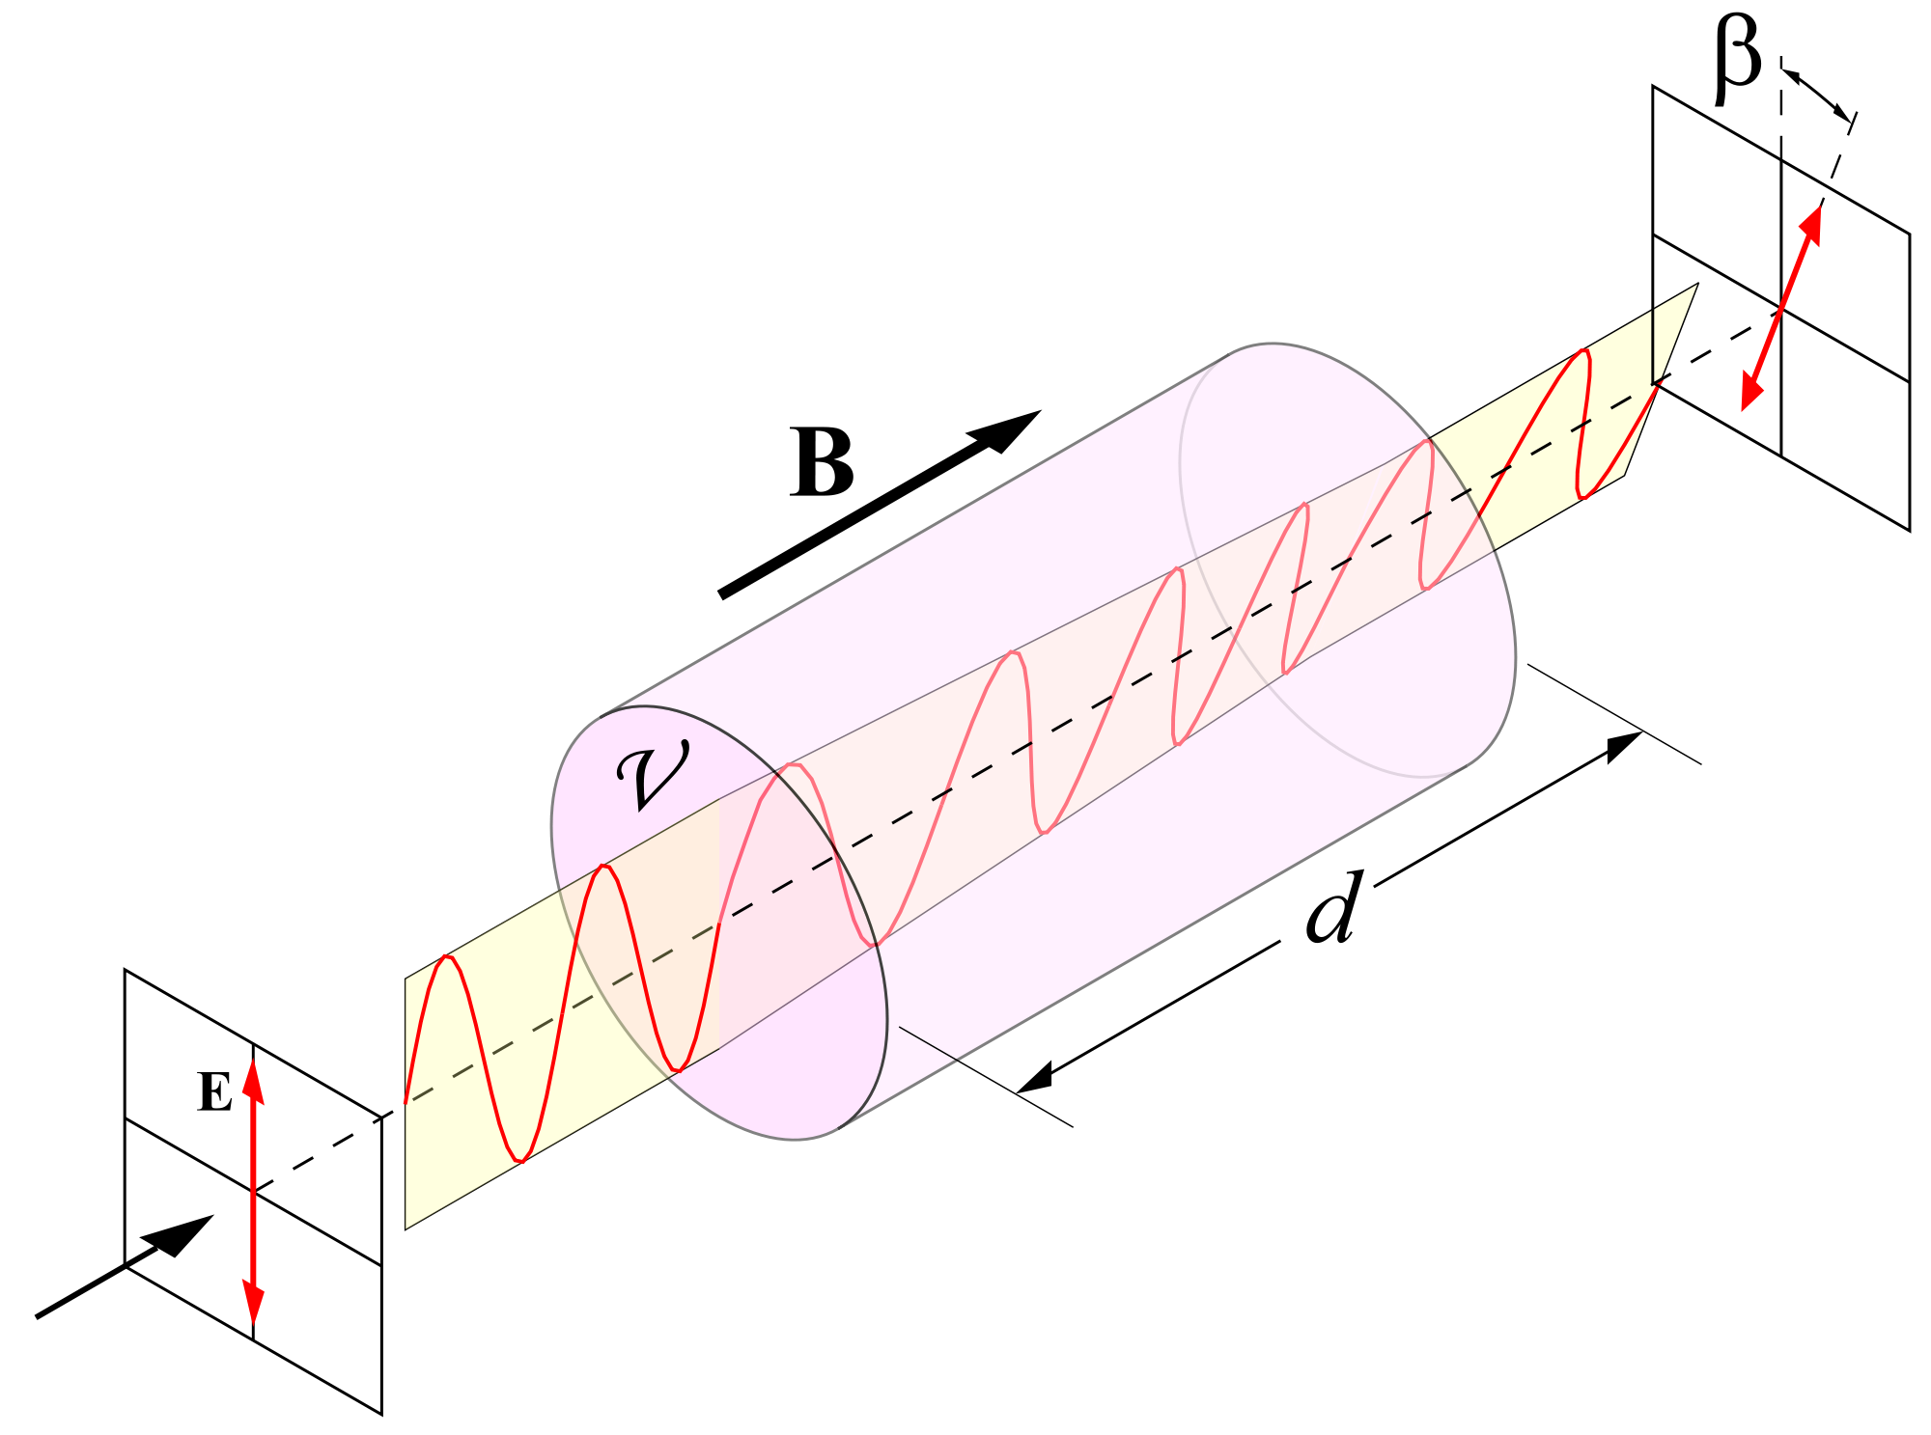
The Faraday effect
Light can be polarized
Polarization is the orientation of the electric field in the electromagnetic wave
Faraday found that light’s polarization changes depending on the magnetic field it travels through

Slide 11
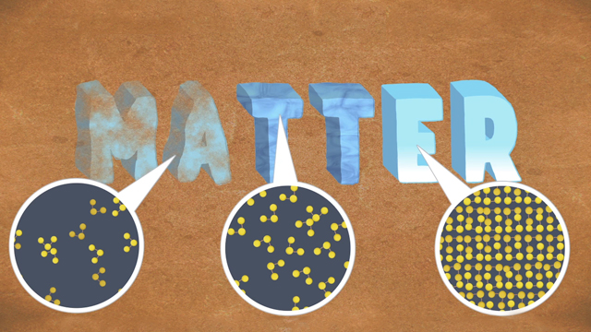
Properties of matter
The Cosmic Perspective, 5.3-5.4

Slide 12

Atoms!
from Greek atomos:
‘indivisible,’ based on a- ‘not’ + temnein ‘to cut.’

Slide 13
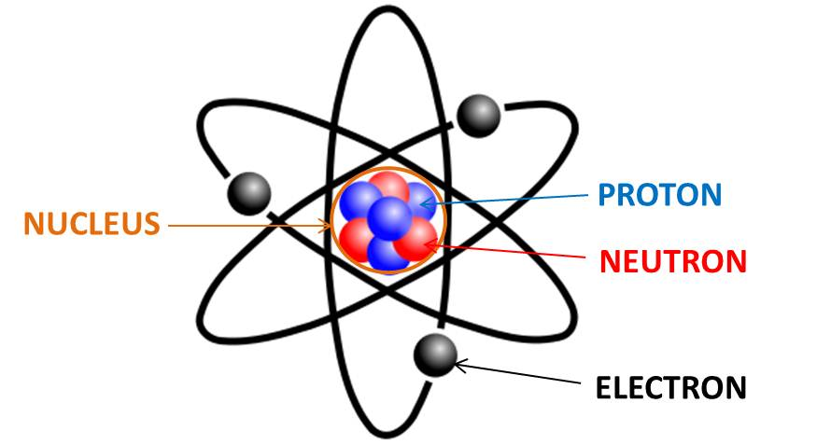
Atomic structure
Proton: +1 charge
Electron: -1 charge
Neutron: 0 charge
Incredibly small– 10⁻¹⁰m across
Proton, neutron, each ~2000x more massive than electron

Slide 14
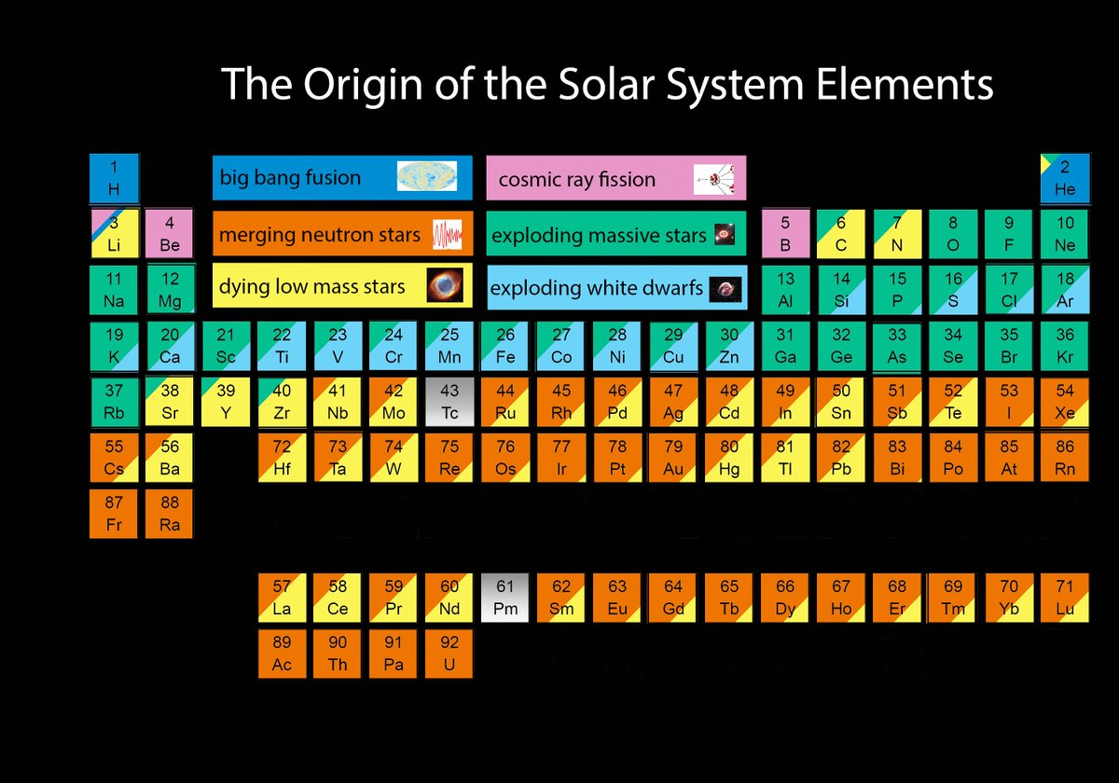
Atomic structure
Atomic number: how many protons in the nucleus
Atomic mass number: combined number of protons and neutrons (recall: mass of electron is tiny tiny!)
Atoms can combine to form molecules
Notes:
https://twitter.com/jajohnson51/status/816827622369935362

Slide 15
Phases of matter
Depends on the phase of matter
Solid
Liquid
Gas
Phase of matter depends on
composition
temperature
pressure

Slide 16
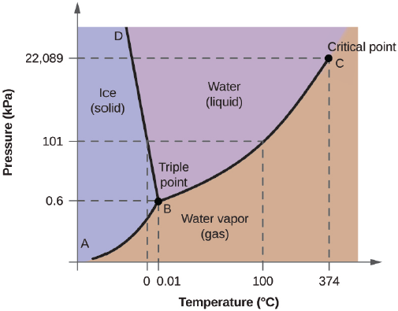
Phases of matter: Water
At low temperature…
Low kinetic energy of molecules
Molecules bound to 4 other molecules
Tightly packed, solid
Increase the temperature…
Kinetic energy increases,
Molecules bond to ~3 other molecules
Loss of rigidity, can now flow: liquid
Increase the temperature even more…
Molecules begin to move freely
Gas phase

Slide 17
Phases of matter: Water
From solid to liquid: melting
From liquid to gas: evaporation
From solid to gas: sublimation

Slide 18
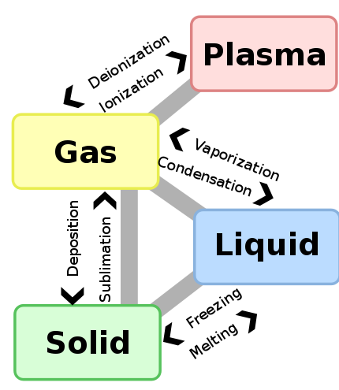
Phases of matter
Beyond the boiling point?
Can break up molecules: molecular dissociation
Adding even more energy can free electrons from atoms: ionization
Ion: an atom with some net charge (either positive or negative)

Slide 19
Phases of matter: the effect of pressure
Pressure is force per unit area
High pressure can keep water in liquid form despite temperature changes
In Earth’s core, it’s hot enough for iron to be molten, but high pressure keeps it a solid
Notes:
High pressure keeps water from going into a gas phase or a solid phase.
Increasing pressure makes it harder for molecules to escape water into a gas phase: the energy required to escape gets higher, the boiling point rises.
In the Earth, the pressure doesn’t allow the iron in earth’s core to move freely, so despite the heat and energy of the iron atoms, they stay tightly bound to their neighbors.

Slide 20
Back to atoms…
Electrons have energy
Discrete energy levels possible
Can gain or lose energy, but only in specific amounts

Slide 21
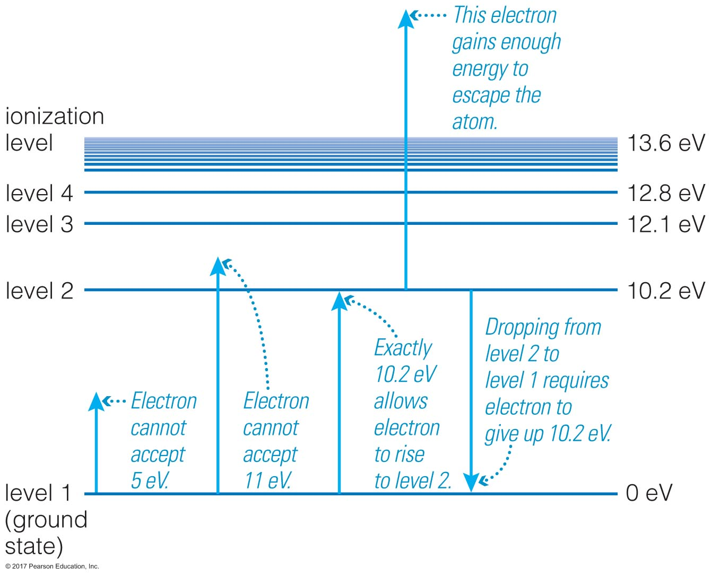
Atomic energy levels
These discrete energy level jumps possible are quantized; called quanta
Origin of quantum mechanics
We use units of energy, eV, electron-volts (where 1 eV ~ 10⁻¹⁹ Joules;1 Joule = 1 g*m²/s²)

Slide 22
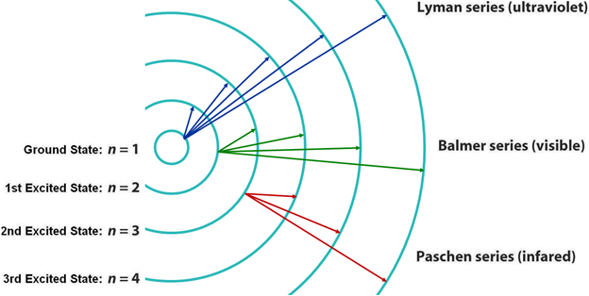
Energy level transitions
Lowest possible energy level is called 0
Other levels are defined relative to that level
When electrons gain energy, they move to higher energy levels
When electrons lose energy, they move to lower levels
How do electrons gain or lose energy?
Gain: absorbing energy from light
Lose: emit light!

Slide 23
Quantized, quantum what now?
Quantum mechanics is weird.
Einstein was unconvinced: “I, in any case, am convinced He does not play dice with the Universe.”
Feynman acknowledged its abstraction: “If you think you understand quantum mechanics, you don’t understand quantum mechanics.”
tl;dr version of quantum mechanics: a way of describing how atoms, and subatomic particles, behave. It’s based in probability and statistics, and accepts there are some measurements you cannot make at the same time. Moved our thoughts on physics from equals signs to inequalities.
Notes:
https://en.wikipedia.org/wiki/Bohr–Einstein_debates

Slide 24
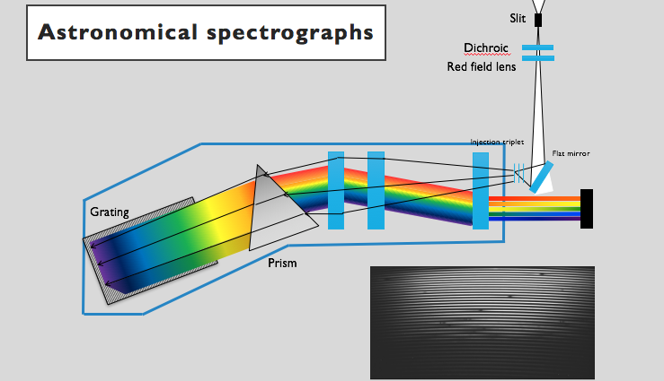
So, what do we do with energy level transitions?
In transitioning between levels, electrons either
Absorb light (energy), or
Lose energy (emit light)
Energy levels for an atom depend on which atom you’re looking at
Each atom has a unique set of possible energy levels: an atomic fingerprint!
We do spectroscopy to measure and analyze a star’s light
A spectrum shows the intensity of light at all wavelengths
Notes:
Inset from lecture 8 slides

Slide 25
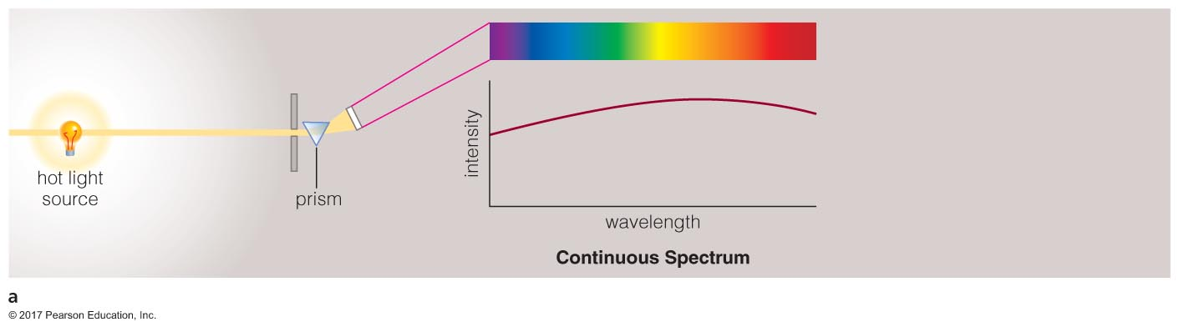
Continuous sources

Slide 26
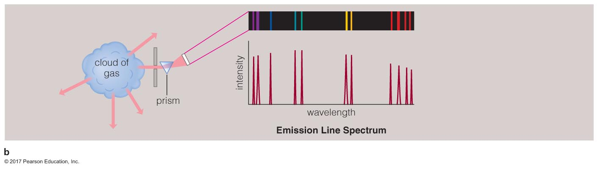
Emission line spectrum

Slide 27
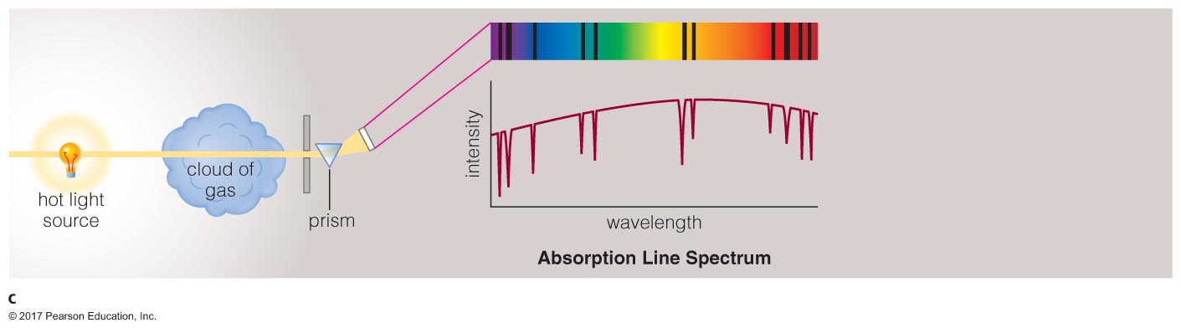
Absorption line spectrum

Slide 28
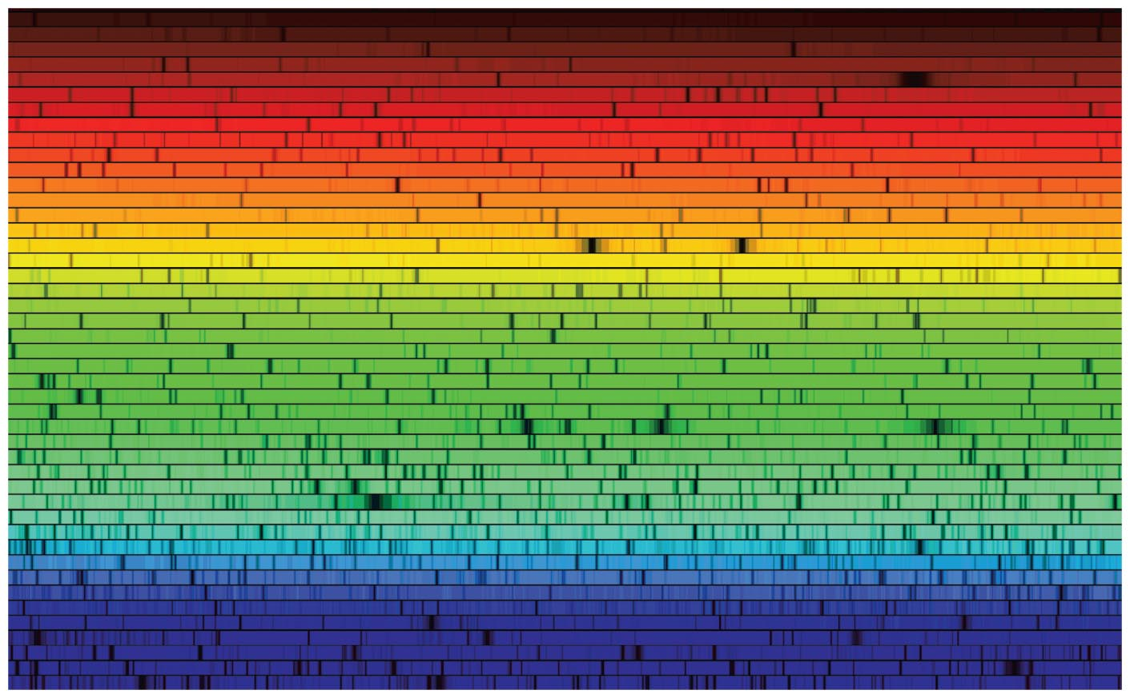
The Sun
Notes:
The spectrum of the sun. you see continuum emission (rainbow colors) and absorption (black lines of various broadness)

Slide 29
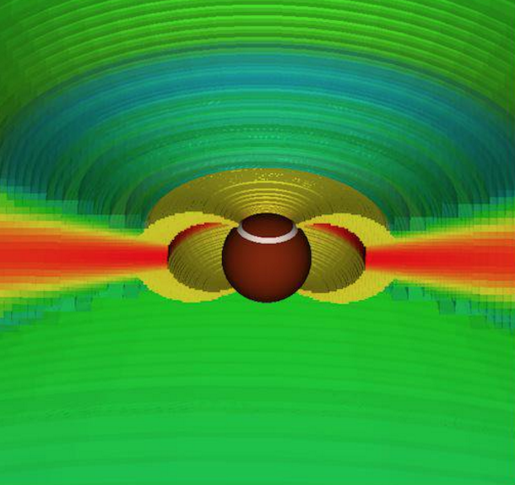
Stellar spectrum: emission, absorption, and continuum
Notes:
On the left, the Hydrogen alpha line of a young star. The x-axis is showing the doppler shift in velocity from the center of the line at 6563A. On the right, a model setup of this star, interacting with a circumstellar disk, via magnetic field.

Slide 30
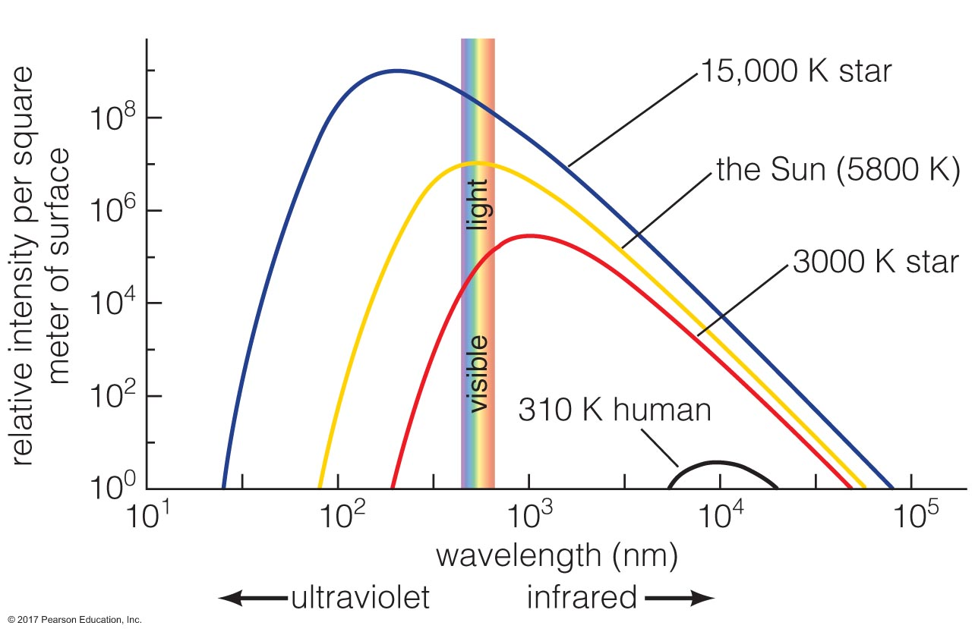
Thermal radiation
On the sun and stars, we see a combination of absorption, emission, and continuum. Where does the continuum come from?
“Blackbody radiation,” which is thermal emission
Depends on an object’s temperature

Slide 31
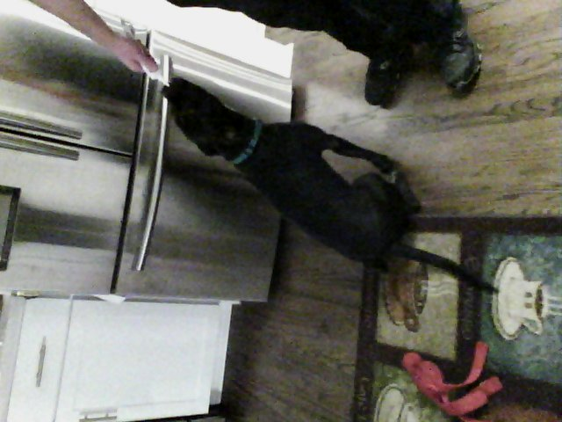
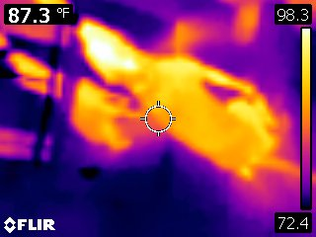
Thermal radiation
Notes:
My dog’s thermal emission, viewed in the infrared. Infrared light also reflects, like off of the stainless fridge!

Slide 32
Two laws of thermal radiation
Stefan-Boltzmann law
When you look at the same size piece of thermally emitting objects, the hotter object always emits more light at all wavelengths
Can see this in curves below
Wien’s law
Hotter objects emit photons with higher average energy
The peak of the intensity curves move bluer as objects are hotter
Affects color of an object. Example: the Sun peaks around green wavelengths

Slide 33
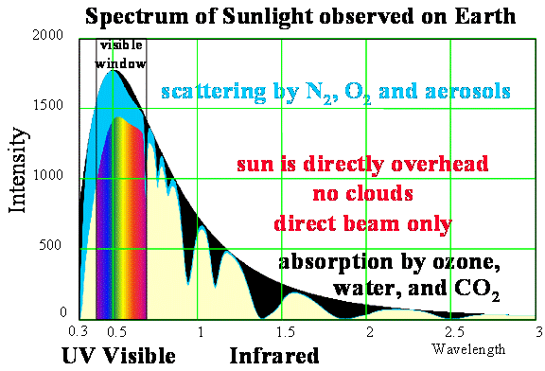
The Sun, again
Notes:
https://web.calpoly.edu/~rfield/Thermalstructure.htm

Slide 34
Doppler effect
As something is moving toward or away from us, the position of the source of a wave is moving, so the observed wavelength *appears* to shift
Imagine an ambulance going by. You hear the tone of the siren changing as it goes by.
Imagine driving the ambulance. You hear the same tone of the siren no matter where you’re going or how fast.
Notes:
http://spiff.rit.edu/classes/phys301/lectures/doppler/doppler.html

Slide 35
Stellar motions
Stars are moving relative to us in the galaxy: we can measure their speeds toward or away from us using the Doppler effect
(We can also measure motions of galaxies toward and away from us)
Notes:
Click the blue box… it goes to https://www.classzone.com/books/earth_science/terc/content/visualizations/es2802/es2802page01.cfm?chapter_no=visualization
What’s wrong with this visualization? It’s cool but there’s definitely something wrong with it…
Some typical radial velocities measured for nearby stars: ~2km/s. Doesn’t sound like much, but it’s about 4500mph!

Slide 36
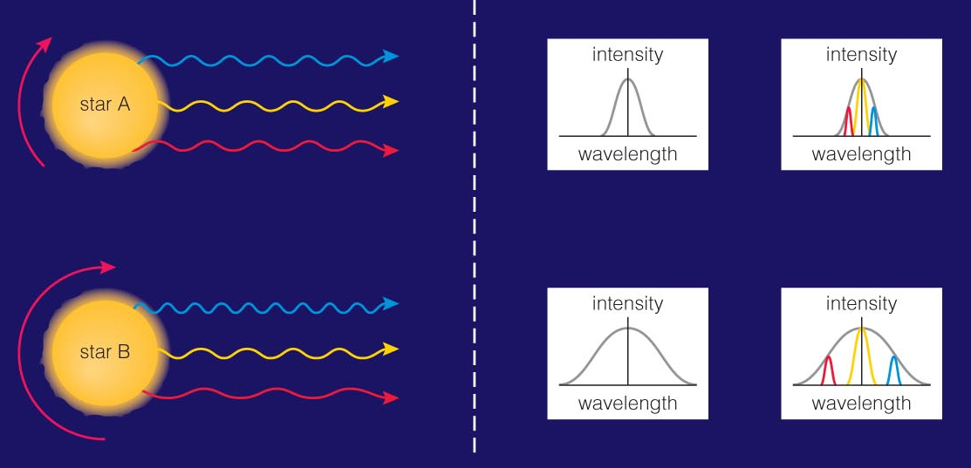
Stellar rotation
As stars rotate, plasma on one side is moving towards us coming into view while plasma on the opposite side is moving out of view, away from us
Rotation of the star has an observable Doppler shift!
Signature is greater the faster a star is rotating

Slide 37
Stellar rotation
As stars rotate, plasma on one side is moving towards us coming into view while plasma on the opposite side is moving out of view, away from us
Rotation of the star has an observable Doppler shift!
Signature is greater the faster a star is rotating
Notes:
http://www.kcvs.ca/martin/astro/course/lectures/fall/a200l10g.htm
https://courses.lumenlearning.com/astronomy/chapter/using-spectra-to-measure-stellar-radius-composition-and-motion/

Slide 38
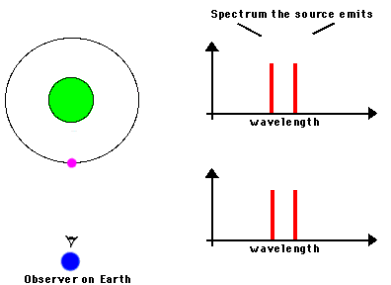
Stellar motion due to planets
We use Doppler shift to detect planets around other stars!
As the planet orbits, it ’tugs’ on the star (both orbit a common center of mass)
The star’s ‘small orbit’ is detectable in its spectrum
x
Notes:
Remember when I forgot to tell you about detecting exoplanets? This is how!
http://www.faculty.virginia.edu/ASTR5110/lectures/spectroscopy/spec.html

Slide 39
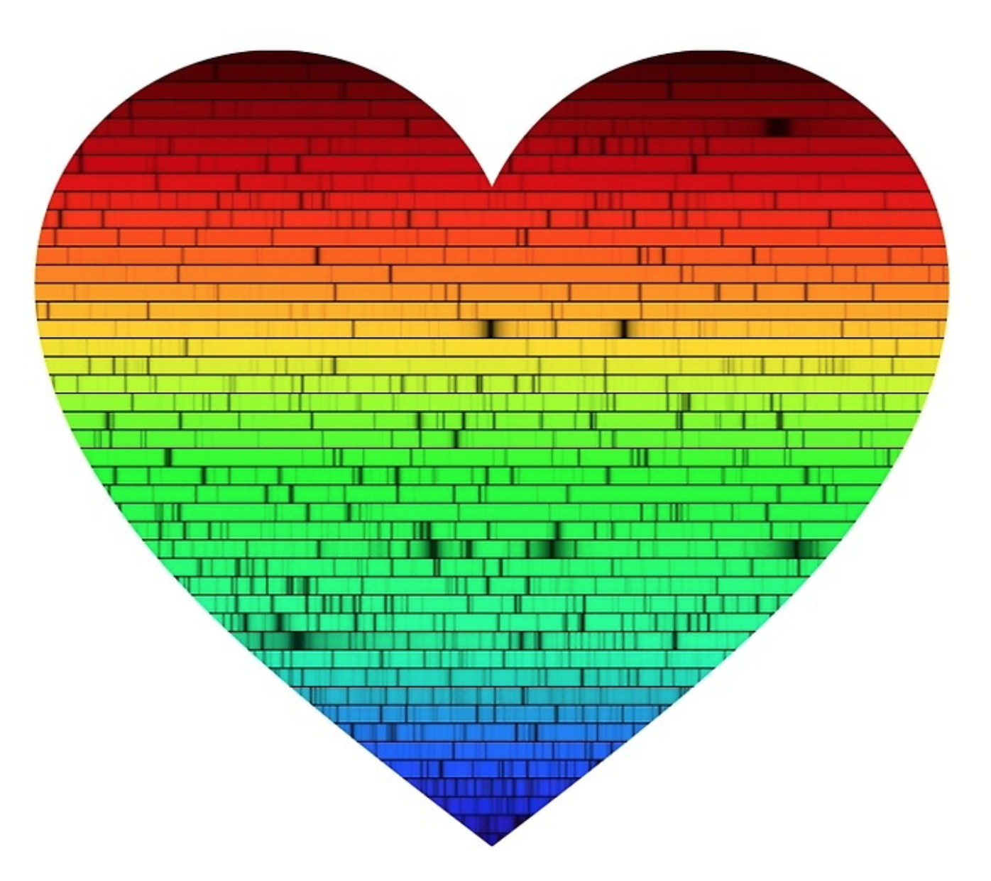
Recap for today
Today, we talked about
Atoms and their structure
Phases of matter
Atomic energy levels
Energy level transitions in atoms
Types of spectra
Thermal radiation
Fingerprints of chemistry, temperature, and motion on spectra
Notes:
https://www.redbubble.com/people/startorialist/works/22175215-one-sun
(not an advertisement)

